Slide 1
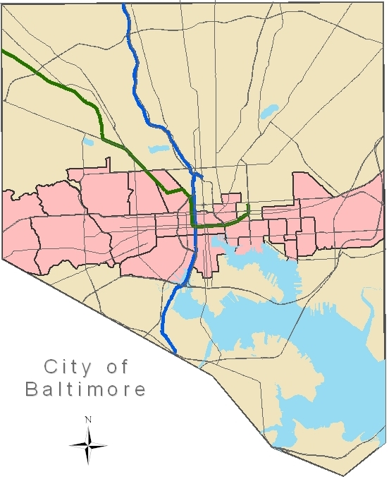
Baltimore’s Red Line Transit Project
14.6 mile Light Rail
10 miles w/in City
20 stops (15 surface, 5 under)
Estimate 44 minutes end-to-end
$1.6 billion

Slide 2
City’s Role
Educate about benefits & opportunities
Promote the project among residents and businesses
Actively promote transit-oriented development (TOD)
Ensure the needs and security of Baltimore City residents take precedence – especially regarding station design
Promote greener environment through planning & construction

Slide 3
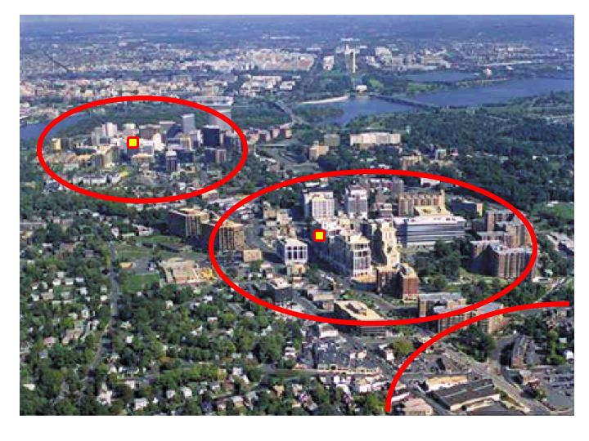
Mayor’s Red Line Summit
Initiative by previous Mayor
Conference-like setting at Convention Center
200+ attendees from all over city
Goal: understand and articulate community vision of success
Presentations from other cities
6 breakout sessions
Notes:
All residents invited
Presentations from Portland, Denver,
Examples of what worked/what didn’t in their projects
Highlighting MANY benefits of transit—focus on big picture
Showed video of what train could look like in Baltimore
Photo: Arlington VA, showing TOD centers around metro stations, the Orange Line along Wilson Blvd

Slide 4
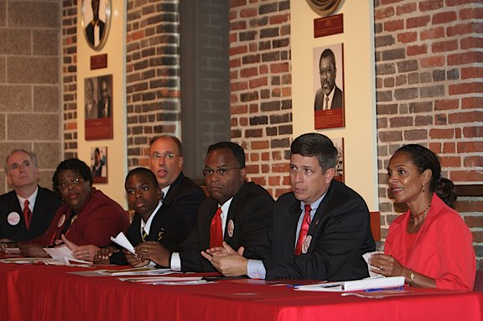
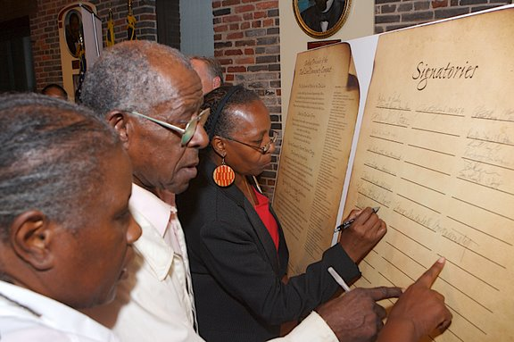
The Red Line Community Compact:
Defining the Success of Baltimore’s
Red Line Transit Project
Collaborative agreement among City & State agencies, non-profit/private entities and communities
Sets specific goals & strategies for all parties
To date, signed by 70 orgs representing multiple stakeholders groups
Notes:
After the summit, groups met through the summer to come to agreement on comprehensive list of goals/strategies for different topics (next slide)

Slide 5
Red Line Community Compact
Putting Baltimore to Work on the Red Line
  Economic Developmt.
  Workforce training & local hiring
Community-Centered Station Design & Stewardship
  N’hood investment
  Foster long-term community process
Making the Red Line Green
  Water quality, alternative energy
  Increase green space
  Health & safety
Aggressively Plan & Manage Construction
  Start early, develop independent monitoring
  Support businesses
  Historic preservation
Notes:
Work: Ensure local residents directly benefit from the $$ coming in to build the project—JOBS
Station: Idea that stations will be activity nodes for neighborhoods, so it is key that residents are involved from Day 1 and continue being involved
Green: Leverage this opportunity to improve sustainability of city as a whole & improve human health along with economic health
Construction: This stage will be difficult and will be the face of the project for 3-5 years; therefore we need to ensure that residents/businesses and historic assets are respected through the process

Slide 6
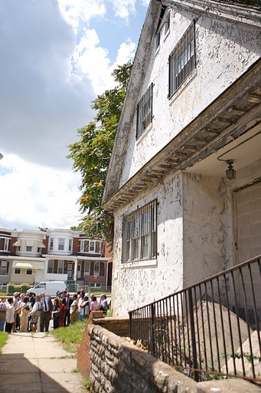
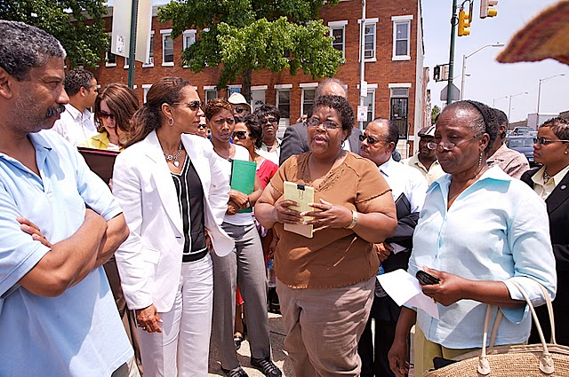
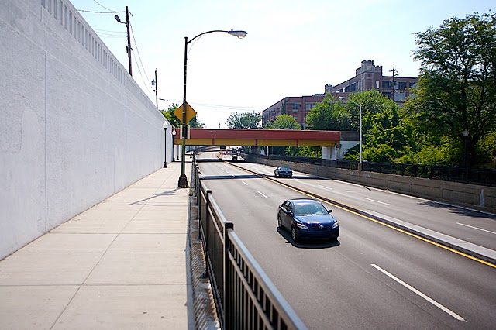
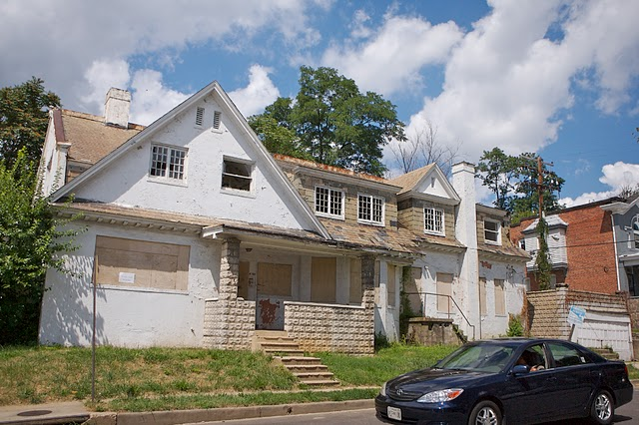
Neighborhood Walking Tours

Slide 7
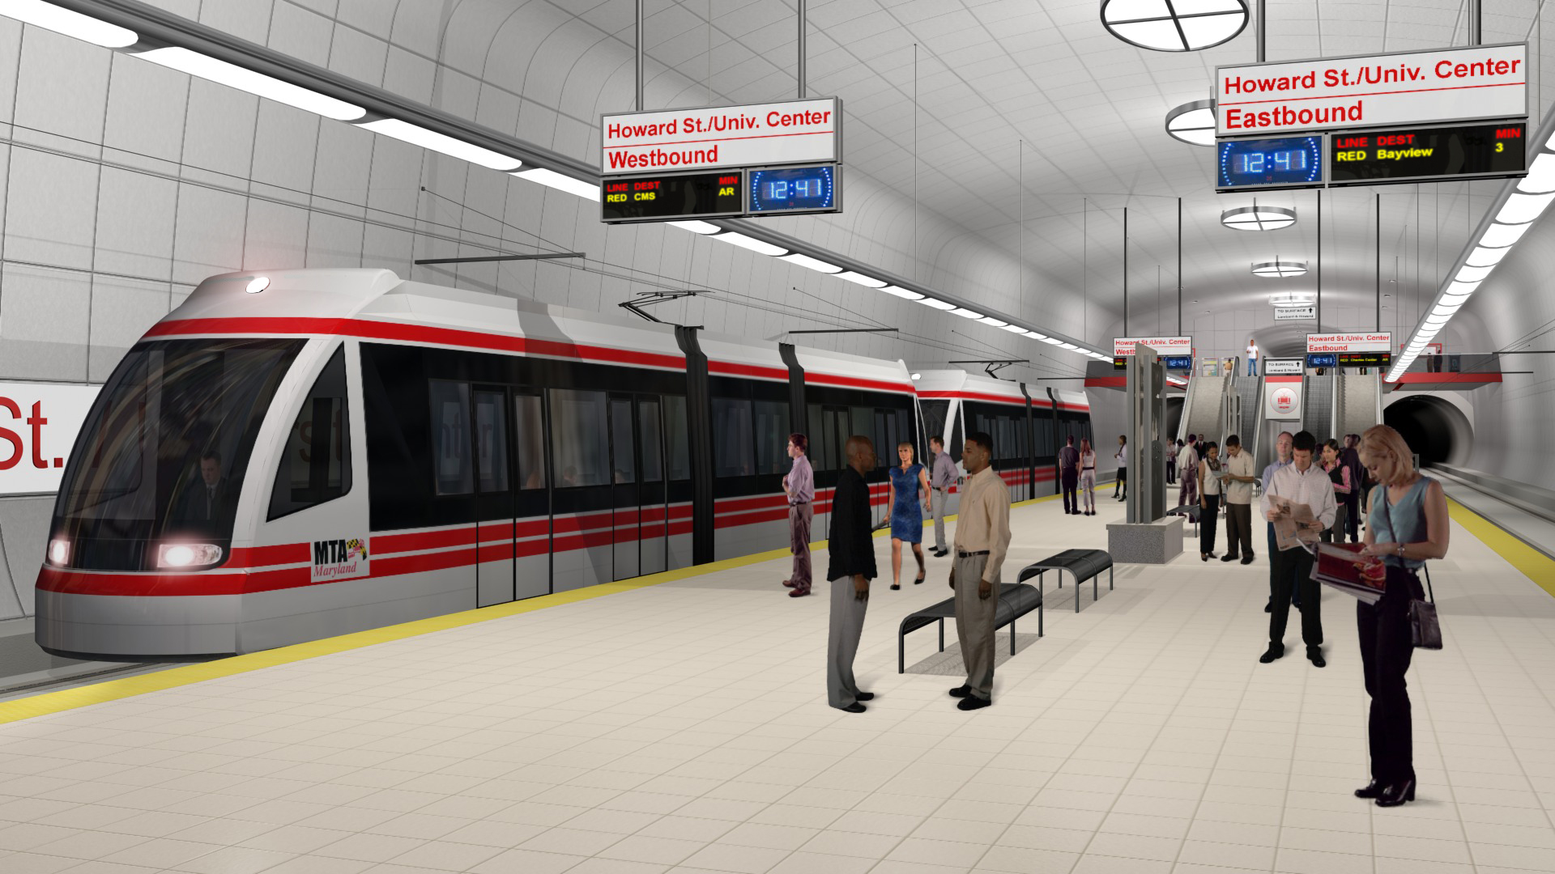
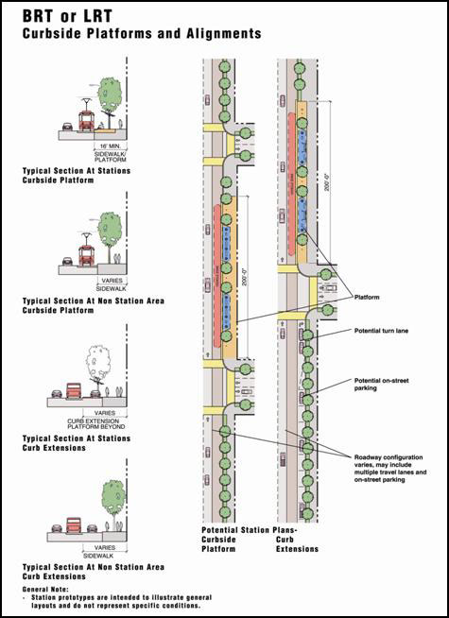
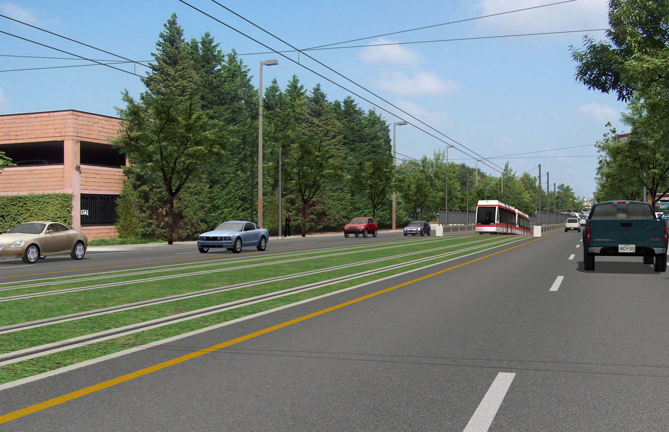
Station Design
Source: MTA website

Slide 8
Station Area Design Committees
Called for in the Community Compact
Teams made up of city/state reps, design experts, and community members
Responsible for station area planning: station design, naming and identifying plans for the immediate ½ mile radius
Different needs:
  If land use planning needed or already completed
  If station in business/Downtown area
  If area requires Community Preservation/ Stabilization

Slide 9
Other things
Timing - Teams assembled this summer at start of PE (preliminary engineering)
Neighborhood liaisons
  Role
  Timing
Design has to serve more than people who live there—citywide access & awareness
www.gobaltimoreredline.com

